Slide 1
Icon Library

Slide 2


Guidelines for Use
This is the official set of Splunk icons for use in non-technical or semi-technical presentations and diagrams. It is derived from our technical icon library developed by our tech docs team.
Please use these official Splunk icons, arrows, boxes and elements in your presentations in order to maintain visual consistency across our sales and marketing efforts.
Third party use – Partners and customers may use the content in the Splunk Icon Libraries in their own presentations and materials only to refer to Splunk products and their use. Distribution of the icons except where used in such presentations and materials is prohibited.

Slide 3














Standard White Splunk Icons
App
Config file
Log file
database
databases
directories
directory
documents
File input
Firewall
Indexer
Index
Search Head
Cluster Master

Slide 4









Standard White Splunk Icons
Generic Server
Laptop
Load Balanced
Heavy Fwder
Universal Fwdr
Lookup
Job Server
Router
Users

Slide 5





















Splunk Icons
Search
Bar chart
Lock
Cloud
Cloud – alt
Folder
Envelope
Storage
Storage - 3
Hadoop storage
Desktop
Laptop
Datacenter
Datacenters
Firewall
Server
Indexer
Forwarder
Search head
Splunk server
Failed server

Slide 6





















Splunk Icons
Application
Application - alt
Virtual machine
Virtual server
Network
www or Global
Tools
Log file
Active Directory
Router
Load balancer
Network Switch
Script
Document
Analyze
Pie chart
Gears/Settings
Gear
Messaging
Tag/ticket
Shield

Slide 7





















Splunk Icons
Android
iPad
iPhone
Checkmark
Alert
Info
Stop
Twitter
Facebook
LinkedIn
RSS
You Tube
GPS Tower
Shopping cart
Healthcare
Hospital
Office building
VoIP Phone
Support
POS Card Reader
RFID

Slide 8



















Splunk Icons
Forwarder - AIX
Forwarder- Datastore
Forwarder- Free BSD
Forwarder- Linux
Forwarder- Windows
Forwarder- Web
Forwarder- OSX
Forwarder- Solaris
Splunk server - AIX
Splunk server - Datastore
Splunk server - Gear
Splunk server - Linux
Splunk server - Network
Splunk server - Web
Splunk server - OSX
Splunk server – Free BSD
Splunk server – Solaris
Failed Splunk server
Splunk search

Slide 9













Splunk Icons

Slide 10






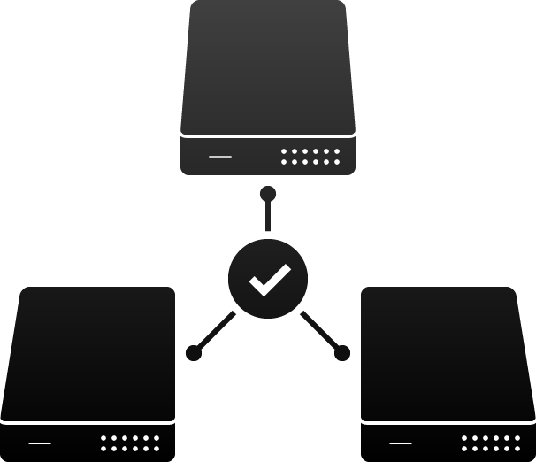





Splunk Icons
Pivot
Analytics Store
Data model
Web
framework
Enhanced search
Predictive
analytics
Cluster management
Forwarder
management
Simple
dashboard
Custom
dashboard
Maps
Home

